Slide 1
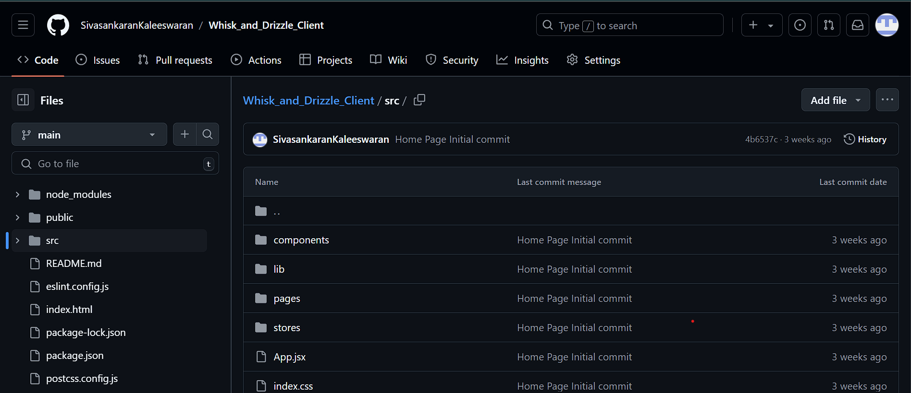
Whisk and Drizzle Front end Git repo

Slide 2
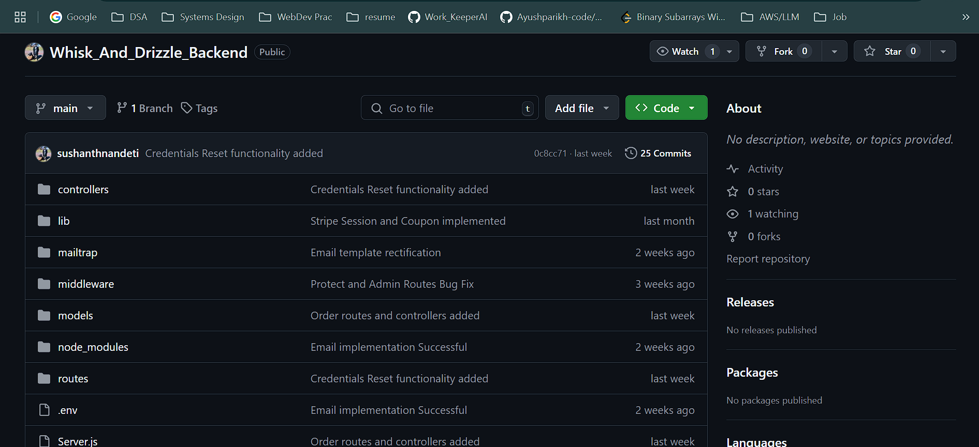
Whisk and Drizzle Back end Git repo

Slide 3
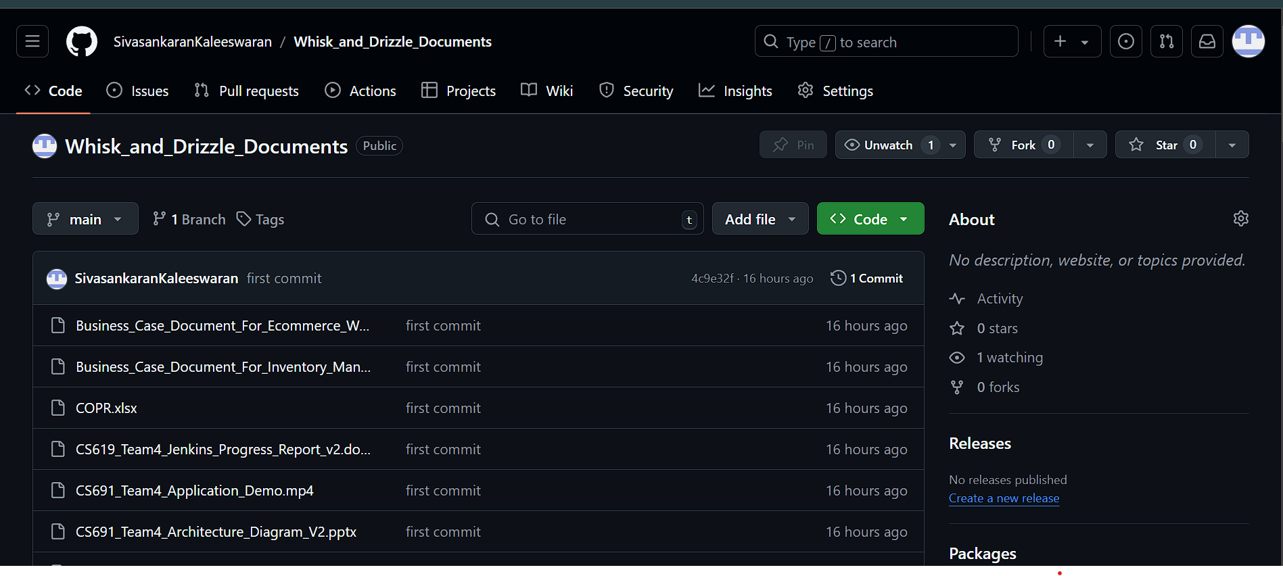
Whisk and Drizzle Project Document Git repo

